Slide 1

Oracle SQL Tuning
An Introduction
Execution
Toon Koppelaars
Sr. IT Architect
Central Bookhouse

Slide 2
CB fact sheet
TX database, R8.1.7.1
  Distribution for 500 publishers and 1200 bookstores
    Daily >150K books distributed
  800 sessions, 40+ application areas
  80 (60) Gbyte, 1700 tables
  1M source lines, 7000 stored objects
  1500 Forms (Designer 1.3.2)
DWH database, R8.1.7.1
  50 sessions, 5 application areas
  100 (80) Gbyte, 350 tables
  300K source lines, 1500 stored objects
  100 html reports (Webserver 3)
  Business Objects

Slide 3

Overview
Foundation
  Optimizer, cost vs. rule, data storage,
  SQL-execution phases, …
Creating & reading execution plans
  Access paths, single table, joins, …
Utilities
  Tracefiles, SQL hints, analyze/dbms_stat
Warehouse specifics
  Star queries & bitmap indexing
  ETL
Availability in 7, 8, 8i, 9i?

Slide 4
Goals
Read execution plans
    Table access
    Index access
    Joins
    Subqueries
Understand execution plans
    Understand performance
    Basic understanding of SQL optimization
Start thinking how you should have executed it

Slide 5
Next…
Basic Concepts (13)
  Background information
SQL-Execution (50)
  Read + understand

Slide 6
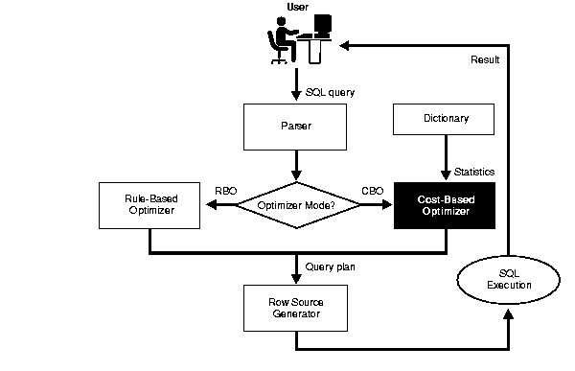
Optimizer Overview
Check syntax +
semantics
Generate plan description
Execute the plan
Transform plan into “executable”

Slide 7
Cost vs. Rule
Rule
  Hardcoded heuristic rules determine plan
    “Access via index is better than full table scan”
    “Fully matched index is better than partially matched index”
    …
Cost (2 modes)
  Statistics of data play role in plan determination
    Best throughput mode: retrieve all rows asap
      First compute, then return fast
    Best response mode: retrieve first row asap
      Start returning while computing (if possible)

Slide 8
How to set which one?
Instance level: Optimizer_Mode parameter
  Rule
  Choose
    if statistics then CBO (all_rows), else RBO
  First_rows, First_rows_n (1, 10, 100, 1000)
  All_rows
Session level:
  Alter session set optimizer_mode=<mode>;
Statement level:
  Hints inside SQL text specify mode to be used

Slide 9
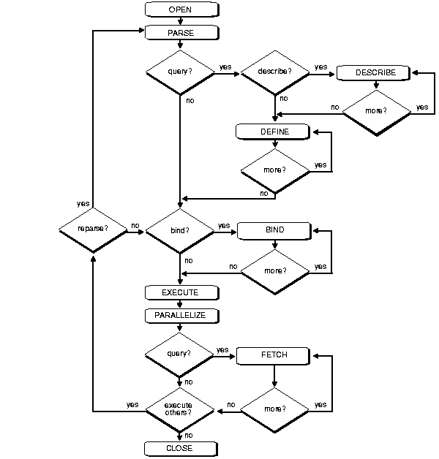
SQL Execution: DML vs. Queries
Describe&define
Bind
Fetch

Slide 10
DML vs. Queries
Open => Parse => Execute (=> Fetch^{n})
SELECT ename,salary
FROM emp
WHERE salary>100000
UPDATE emp
SET commission=‘N’
WHERE salary>100000
CLIENT SERVER
Fetches done
By client
Same SQL optimization
All fetches done internally
by SQL-Executor
=> SQL =>
<= Data or Returncode<=

Slide 11
Data Storage: Tables
Oracle stores all data inside datafiles
  Location & size determined by DBA
  Logically grouped in tablespaces
  Each file is identified by a relative file number (fno)
Datafile consists of data-blocks
  Size equals value of db_block_size parameter
  Each block is identified by its offset in the file
Data-blocks contain rows
  Each row is identified by its sequence in the block
ROWID: <Block>.<Row>.<File>

Slide 12
Data Storage: Tables
File x
Block 1
Block 2
Block 3
Block 4
Block 5
Block …
<Rec1><Rec2><Rec3>
<Rec4><Rec5><Rec6>
<Rec7><Rec8><Rec9>
…
Rowid: 00000006.0000.000X

Slide 13
Data Storage: Indexes
Balanced trees
  Indexed column(s) sorted and stored seperately
    NULL values are excluded (not added to the index)
  Pointer structure enables logarithmic search
    Access index first, find pointer to table, then access table
B-trees consist of
  Node blocks
    Contain pointers to other node, or leaf blocks
  Leaf blocks
    Contain actual indexed values
    Contain rowids (pointer to rows)
Also stored in blocks in datafiles
  Proprietary format

Slide 14
Data Storage: Indexes
B-tree
Create index on emp(empno)
< BLEVEL >
NODES
<100 100..200 >200
<50 50..100 100..150 150..200 200..250 >250
value
value
value
value
value
value
value
value
value
value
value
value
value
value
value
value
value
value
value
value
value
value
value
value
value
value
value
value
LEAVES
rowid
rowid
rowid
rowid
rowid
rowid
rowid
rowid
rowid
rowid
rowid
rowid
rowid
rowid
rowid
rowid
rowid
rowid
rowid
rowid
rowid
rowid
rowid
rowid
rowid
rowid
rowid
rowid

Slide 15
Data Storage: Indexes
Datafile
Block 1
Block 2
Block 3
Block 4
Block 5
Block …
Index
Node
Block
Index
Leaf
Block
Index
Leaf
Block
No particular order of node and leaf blocks

Slide 16
Table & Index I/O
I/O’s are done at ‘block level’
  LRU list controls who ‘makes place’ in the cache
Disc
Memory: SGA -
buffer cache (x blocks)
Datafile
Data
Access
I/O’s
SQL Executor

Slide 17
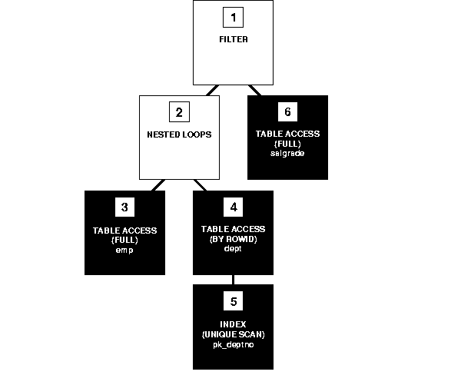
Explain Plan Utility
“Explain plan for <SQL-statement>”
  Stores plan (row-sources + operations) in Plan_Table
  View on Plan_Table (or 3rd party tool) formats into readable plan
1
>Filter
>….NL
>……..TA-full
>……..TA-rowid
>…………Index Uscan
>….TA-full
2
3
4
5
6

Slide 18
Explain Plan Utility
create table PLAN_TABLE (
statement_id varchar2(30), operation varchar2(30),
options varchar2(30), object_owner varchar2(30),
object_name varchar2(30), id numeric,
parent_id numeric, position numeric,
cost numeric, bytes numeric);
create or replace view PLANS(STATEMENT_ID,PLAN,POSITION) as
select statement_id,
rpad('>',2*level,'.')||operation||
decode(options,NULL,'',' (')||nvl(options,' ')||
decode(options,NULL,'',') ')||
decode(object_owner,NULL,'',object_owner||'.')||object_name plan,
position
from plan_table
start with id=0
connect by prior id=parent_id
and prior nvl(statement_id,'NULL')=nvl(statement_id,'NULL')

Slide 19
Execution Plans
Single table without index
Single table with index
Joins
  Nested Loop
  Sort Merge
  Hash1 (small/large), hash2 (large/large)
Special operators

Slide 20
Single Table, no Index (1.1)
SELECT *
FROM emp;
>.SELECT STATEMENT
>...TABLE ACCESS full emp
Full table scan (FTS)
  All blocks read sequentially into buffer cache
    Also called “buffer-gets”
    Done via multi-block I/O’s (db_file_multiblock_read_count)
    Till high-water-mark reached (truncate resets, delete not)
  Per block: extract + return all rows
    Then put block at LRU-end of LRU list (!)
    All other operations put block at MRU-end

Slide 21
Single Table, no Index (1.2)
SELECT *
FROM emp
WHERE sal > 100000;
>.SELECT STATEMENT
>...TABLE ACCESS full emp
Full table scan with filtering
  Read all blocks
  Per block extract, filter, then return row
    Simple where-clause filters never shown in plan
    FTS with: rows-in < rows-out

Slide 22
Single Table, no Index (1.3)
SELECT *
FROM emp
ORDER BY ename;
>.SELECT STATEMENT
>...SORT order by
>.....TABLE ACCESS full emp
FTS followed by sort on ordered-by column(s)
  “Followed by” Ie. SORT won’t return rows to its parent row-source till its child row-source fully completed
  SORT order by: rows-in = rows-out
  Small sorts done in memory (SORT_AREA_SIZE)
  Large sorts done via TEMPORARY tablespace
    Potentially many I/O’s

Slide 23
Single Table, no Index (1.3)
SELECT *
FROM emp
ORDER BY ename;
Emp(ename)
>.SELECT STATEMENT
>...TABLE ACCESS full emp
>.....INDEX full scan i_emp_ename
If ordered-by column(s) is indexed
  Index Full Scan
  CBO uses index if mode = First_Rows
  If index is used => no sort is necessary

Slide 24
Single Table, no Index (1.4)
SELECT job,sum(sal)
FROM emp
GROUP BY job;
>.SELECT STATEMENT
>...SORT group by
>.....TABLE ACCESS full emp
FTS followed by sort on grouped-by column(s)
  FTS will only retrieve job and sal columns
    Small intermediate rowlength => sort more likely in memory
  SORT group by: rows-in >> rows-out
  Sort also computes aggregates

Slide 25
Single Table, no Index (1.5)
SELECT job,sum(sal)
FROM emp
GROUP BY job
HAVING sum(sal)>200000;
>.SELECT STATEMENT
>...FILTER
>.....SORT group by
>.......TABLE ACCESS full emp
HAVING Filtering
  Only filter rows that comply to having-clause

Slide 26
Single Table, no Index (1.6)
SELECT *
FROM emp
WHERE rowid=
‘00004F2A.00A2.000C’
>.SELECT STATEMENT
>...TABLE ACCESS by rowid emp
Table access by rowid
  Single row lookup
  Goes straight to the block, and filters the row
  Fastest way to retreive one row
    If you know its rowid

Slide 27
Single Table, Index (2.1)
SELECT *
FROM emp
WHERE empno=174;
Unique emp(empno)
>.SELECT STATEMENT
>...TABLE ACCESS by rowid emp
>.....INDEX unique scan i_emp_pk
Index Unique Scan
  Traverses the node blocks to locate correct leaf block
  Searches value in leaf block (if not found => done)
  Returns rowid to parent row-source
    Parent: accesses the file+block and returns the row

Slide 28
Index Unique Scan (2.1)
Table access
by rowid

Slide 29
Single Table, Index (2.2)
SELECT *
FROM emp
WHERE job=‘manager’;
emp(job)
>.SELECT STATEMENT
>...TABLE ACCESS by rowid emp
>.....INDEX range scan i_emp_job
(Non-unique) Index Range Scan
  Traverses the node blocks to locate most left leaf block
  Searches 1st occurrence of value in leaf block
  Returns rowid to parent row-source
    Parent: accesses the file+block and returns the row
  Continues on to next occurrence of value in leaf block
    Until no more occurences

Slide 30
Index Range Scan (2.2)
Table access
by rowid

Slide 31
Single Table, Index (2.3)
SELECT *
FROM emp
WHERE empno>100;
Unique emp(empno)
>.SELECT STATEMENT
>...TABLE ACCESS by rowid emp
>.....INDEX range scan i_emp_pk
Unique Index Range Scan
  Traverses the node blocks to locate most left leaf block with start value
  Searches 1st occurrence of value-range in leaf block
  Returns rowid to parent row-source
    Parent: accesses the file+block and returns the row
  Continues on to next valid occurrence in leaf block
    Until no more occurences / no longer in value-range

Slide 32
Concatenated Indexes
Emp(job,hiredate)
Job1 Job2 Job3
Hiredates
Hiredates
Hiredates
Multiple levels of Btrees, by column order

Slide 33
Single Table, Index (2.4)
SELECT *
FROM emp
WHERE job=‘manager’
AND hiredate=’01-01-2001’;
Emp(job,hiredate)
>.SELECT STATEMENT
>...TABLE ACCESS by rowid emp
>.....INDEX range scan i_emp_j_h
Full Concatenated Index
  Use job-value to navigate to sub-Btree
  Then search all applicable hiredates

Slide 34
Single Table, Index (2.5)
SELECT *
FROM emp
WHERE job=‘manager’;
Emp(job,hiredate)
>.SELECT STATEMENT
>...TABLE ACCESS by rowid emp
>.....INDEX range scan i_emp_j_h
(Leading) Prefix of Concatenated Index
  Scans full sub-Btree inside larger Btree

Slide 35
Index Range Scan (2.5)
emp(job,hiredate)
job-values
hiredate-values
SELECT *
FROM emp
WHERE job=‘manager’;
Table access
by rowid

Slide 36

Single Table, Index (2.6)
SELECT *
FROM emp
WHERE hiredate=’01-01-2001’;
Emp(job,hiredate)
>.SELECT STATEMENT
>...TABLE ACCESS by rowid emp
>.....INDEX range scan i_emp_j_h
Index Skip Scan (prior versions did FTS)
  “To use indexes where they’ve never been used before”
  Predicate on leading column(s) no longer needed
  Views Btree as collection of smaller sub-Btrees
  Works best with low-cardinality leading column(s)

Slide 37
Index Skip Scan (2.6)
Each node holds min and max
hiredates
emp(job,hiredate)
job-values
hiredate-values
SELECT *
FROM emp
WHERE hiredate=’01-01-2001’;

Slide 38
Single Table, Index (2.7)
SELECT *
FROM emp
WHERE empno>100
AND job=‘manager’;
Unique Emp(empno)
Emp(job)
>.SELECT STATEMENT
>...TABLE ACCESS by rowid emp
>.....INDEX range scan i_emp_job
Multiple Indexes
  Rule: uses heuristic decision list to choose which one
    Avaliable indexes are ‘ranked’
  Cost: computes most selective one (ie. least costing)
    Uses statistics

Slide 39
RBO Heuristics
Ranking multiple available indexes
  Equality on single column unique index
  Equality on concatenated unique index
  Equality on concatenated index
  Equality on single column index
  Bounded range search in index
    Like, Between, Leading-part, …
  Unbounded range search in index
    Greater, Smaller (on leading part)
  Normally you hint which one to use

Slide 40
CBO Cost Computation
Statistics at various levels
    Table:
      Num_rows, Blocks, Empty_blocks, Avg_space
    Column:
      Num_values, Low_value, High_value, Num_nulls
    Index:
      Distinct_keys, Blevel, Avg_leaf_blocks_per_key, Avg_data_blocks_per_key, Leaf_blocks
  Used to compute selectivity of each index
    Selectivity = percentage of rows returned
      Number of I/O’s plays big role
    FTS is also considered at this time!

Slide 41
Single Table, Index (2.1)
SELECT *
FROM emp
WHERE empno=174;
Unique emp(empno)
>.SELECT STATEMENT
>...TABLE ACCESS by rowid emp
>.....INDEX unique scan i_emp_pk
Or,
>.SELECT STATEMENT
>...TABLE ACCESS full emp
CBO will use Full Table Scan If,
# of I/O’s to do FTS < # of I/O’s to do IRS
  FTS I/O uses db_file_multiblock_read_count (dfmrc)
    Typically 16
  Unique scan uses: (blevel + 1) +1 I/O’s
  FTS uses ceil(#table blocks / dfmrc) I/O’s

Slide 42
CBO: Clustering Factor
Index level statistic
  How well ordered are the rows in comparison to indexed values?
  Average number of blocks to access a single value
    1 means range scans are cheap
    <# of table blocks> means range scans are expensive
  Used to rank multiple available range scans
Blck 1 Blck 2 Blck 3
------ ------ ------
A A A B B B C C C
Blck 1 Blck 2 Blck 3
------ ------ ------
A B C A B C A B C
Clust.fact = 1
Clust.fact = 3

Slide 43
Single Table, Index (2.2)
SELECT *
FROM emp
WHERE job=‘manager’;
emp(job)
>.SELECT STATEMENT
>...TABLE ACCESS by rowid emp
>.....INDEX range scan i_emp_job
Or,
>.SELECT STATEMENT
>...TABLE ACCESS full emp
Clustering factor comparing IRS against FTS
  If, (#table blocks / dfmrc)
  <
  (#values * clust.factor) + blevel + leafblocks-to-visit
  then, FTS is used

Slide 44
Single Table, Index (2.7)
SELECT *
FROM emp
WHERE empno>100
AND job=‘manager’;
Unique Emp(empno)
Emp(job)
>.SELECT STATEMENT
>...TABLE ACCESS by rowid emp
>.....INDEX range scan i_emp_job
Or,
>.SELECT STATEMENT
>...TABLE ACCESS by rowid emp
>.....INDEX range scan i_emp_empno
Clust.factor comparing multiple IRS’s
  Suppose FTS is too many I/O’s
  Compare (#values * clust.fact) to decide which index
    Empno-selectivity => #values * 1 => # I/O’s
    Job-selectivity => 1 * clust.fact => # I/O’s

Slide 45
Single Table, Index (2.8)
SELECT *
FROM emp
WHERE job=‘manager’
AND depno=10
Emp(job)
Emp(depno)
>.SELECT STATEMENT
>...TABLE ACCESS by rowid emp
>.....AND-EQUAL
>.......INDEX range scan i_emp_job
>.......INDEX range scan i_emp_depno
Multiple same-rank, single-column indexes
  AND-EQUAL: merge up to 5 single column range scans
  Combines multiple index range scans prior to table access
    Intersects rowid sets from each range scan
  Rarely seen with CBO

Slide 46
Single Table, Index (2.9)
SELECT ename
FROM emp
WHERE job=‘manager’;
Emp(job,ename)
>.SELECT STATEMENT
>...INDEX range scan i_emp_j_e
Using indexes to avoid table access
  Depending on columns used in SELECT-list and other places of WHERE-clause
  No table-access if all used columns present in index

Slide 47
Single Table, Index (2.10)
SELECT count(*)
FROM big_emp;
Big_emp(empno)
>.SELECT STATEMENT
>...INDEX fast full scan i_emp_empno
Fast Full Index Scan (CBO only)
  Uses same multiblock I/O as FTS
  Eligible index must have at least one NOT NULL column
  Rows are returned leaf-block order
    Not in indexed-columns-order

Slide 48
Joins, Nested Loops (3.1)
SELECT *
FROM dept, emp;
>.SELECT STATEMENT
>...NESTED LOOPS
>.....TABLE ACCESS full dept
>.....TABLE ACCESS full emp
Full Cartesian Product via Nested Loop Join (NLJ)
  Init(RowSource1);
  While not eof(RowSource1)
  Loop Init(RowSource2);
  While not eof(RowSource2)
  Loop return(CurRec(RowSource1)+CurRec(RowSource2));
  NxtRec(RowSource2);
  End Loop;
  NxtRec(RowSource1);
  End Loop;
Two loops,
nested

Slide 49
Joins, Sort Merge (3.2)
SELECT *
FROM emp, dept
WHERE emp.d# = dept.d#;
>.SELECT STATEMENT
>...MERGE JOIN
>.....SORT join
>.......TABLE ACCESS full emp
>.....SORT join
>.......TABLE ACCESS full dept
Inner Join, no indexes: Sort Merge Join (SMJ)
  Tmp1 := Sort(RowSource1,JoinColumn);
  Tmp2 := Sort(RowSource2,JoinColumn);
  Init(Tmp1); Init(Tmp2);
  While Sync(Tmp1,Tmp2,JoinColumn)
  Loop return(CurRec(Tmp1)+CurRec(Tmp2));
  End Loop;
Sync advances
pointer(s) to
next match

Slide 50
Joins (3.3)
SELECT *
FROM emp, dept
WHERE emp.d# = dept.d#;
Emp(d#)
>.SELECT STATEMENT
>...NESTED LOOPS
>.....TABLE ACCESS full dept
>.....TABLE ACCESS by rowid emp
>.......INDEX range scan e_emp_fk
Inner Join, only one side indexed
  NLJ starts with full scan of non-indexed table
  Per row retrieved use index to find matching rows
    Within 2nd loop a (current) value for d# is available!
    And used to perform a range scan

Slide 51
Joins (3.4)
SELECT *
FROM emp, dept
WHERE emp.d# = dept.d#
Emp(d#)
Unique Dept(d#)
>.SELECT STATEMENT
>...NESTED LOOPS
>.....TABLE ACCESS full dept
>.....TABLE ACCESS by rowid emp
>.......INDEX range scan e_emp_fk
Or,
>.SELECT STATEMENT
>...NESTED LOOPS
>.....TABLE ACCESS full emp
>.....TABLE ACCESS by rowid dept
>.......INDEX unique scan e_dept_pk
Inner Join, both sides indexed
  RBO: NLJ, start with FTS of last table in FROM-clause
  CBO: NLJ, start with FTS of biggest table in FROM-clause
    Best multi-block I/O benefit in FTS
    More likely smaller table will be in buffer cache

Slide 52
Joins (3.5)
SELECT *
FROM emp, dept
WHERE emp.d# = dept.d#
AND dept.loc = ‘DALLAS’
Emp(d#)
Unique Dept(d#)
>.SELECT STATEMENT
>...NESTED LOOPS
>.....TABLE ACCESS full dept
>.....TABLE ACCESS by rowid emp
>.......INDEX range scan e_emp_fk
Inner Join with additional conditions
  Nested Loops
  Always starts with table thas has extra condition(s)

Slide 53
Hashing
Table
rows
Hash Function
Eg. Mod(cv,3)
rows
Buckets
rows
Domain =
Column Values (cv)
Range =
Hash Values
(offset)
rows
SELECT *
FROM table
WHERE column = <value>
Card. of range
determines size
of bucket
Equality search in where clause

Slide 54
Joins, Hash (3.6)
SELECT *
FROM dept, emp
WHERE dept.d# = emp.d#
Emp(d#), Unique Dept(d#)
>.SELECT STATEMENT
>...HASH JOIN
>.....TABLE ACCESS full dept
>.....TABLE ACCESS full emp
  Tmp1 := Hash(RowSource1,JoinColumn); -- In memory
  Init(RowSource2);
  While not eof(RowSource2)
  Loop HashInit(Tmp1,JoinValue); -- Locate bucket
  While not eof(Tmp1)
  Loop return(CurRec(RowSource2)+CurRec(Tmp1));
  NxtHashRec(Tmp1,JoinValue);
  End Loop; NxtRec(RowSource2);
  End Loop;

Slide 55
Joins, Hash (3.6)
Must be explicitely enabled via init.ora file:
  Hash_Join_Enabled = True
  Hash_Area_Size = <bytes>
If hashed table does not fit in memory
  1st rowsource: temporary hash cluster is built
    And written to disk (I/O’s) in partitions
  2nd rowsource also converted using same hash-function
  Per ‘bucket’ rows are matched and returned
    One bucket must fit in memory, else very bad performance

Slide 56
Subquery (4.1)
SELECT dname, deptno
FROM dept
WHERE d# IN
(SELECT d#
FROM emp);
>.SELECT STATEMENT
>...NESTED LOOPS
>.....VIEW
>.......SORT unique
>.........TABLE ACCESS full emp
>.....TABLE ACCESS by rowid dept
>.......INDEX unique scan i_dept_pk
Transformation into join
  Temporary view is built which drives the nested loop

Slide 57
Subquery, Correlated (4.2)
SELECT *
FROM emp e
WHERE sal >
(SELECT sal
FROM emp m
WHERE m.e#=e.mgr#)
>.SELECT STATEMENT
>...FILTER
>.....TABLE ACCESS full emp
>.....TABLE ACCESS by rowid emp
>.......INDEX unique scan i_emp_pk
“Nested Loops”-like FILTER
  For each row of 1st rowsource, execute 2nd rowsource
  and filter on truth of subquery-condition
  Subquery can be re-written as self-join of EMP table

Slide 58
Subquery, Correlated (4.2)
SELECT *
FROM emp e, emp m
WHERE m.e#=e.mgr#
AND e.sal > m.sal;
>.SELECT STATEMENT
>...NESTED LOOPS
>.....TABLE ACCESS full emp
>.....TABLE ACCESS by rowid emp
>.......INDEX unique scan i_emp_pk
Subquery rewrite to join
  Subquery can also be rewritten to EXISTS-subquery

Slide 59
Subquery, Correlated (4.2)
SELECT *
FROM emp e
WHERE exists
(SELECT ‘less salary'
FROM emp m
WHERE e.mgr# = m.e#
and m.sal < e.sal);
>.SELECT STATEMENT
>...FILTER
>.....TABLE ACCESS full emp
>.....TABLE ACCESS by rowid emp
>.......INDEX unique scan i_emp_pk
Subquery rewrite to EXISTS query
  For each row of 1st rowsource, execute 2nd rowsource
  And filter on retrieval of rows by 2nd rowsource

Slide 60
Concatenation (4.3)
SELECT *
FROM emp
WHERE mgr# = 100
OR job = ‘CLERK’;
Emp(mgr#)
Emp(job)
>.SELECT STATEMENT
>...CONCATENATION
>.....TABLE ACCESS by rowid emp
>.......INDEX range scan i_emp_m
>.....TABLE ACCESS by rowid emp
>.......INDEX range scan i_emp_j
Concatenation (OR-processing)
  Similar to query rewrite into 2 seperate queries
  Which are then ‘concatenated’
  If one index was missing => Full Table Scan

Slide 61
Inlist Iterator (4.4)
SELECT *
FROM dept
WHERE d# in (10,20,30);
Unique Dept(d#)
>.SELECT STATEMENT
>...INLIST ITERATOR
>.....TABLE ACCESS by rowid dept
>.......INDEX unique scan i_dept_pk
Iteration over enumerated value-list
  Every value executed seperately
Same as concatenation of 3 “OR-red” values

Slide 62
Union (4.5)
SELECT empno
FROM emp
UNION
SELECT deptno
FROM dept;
>.SELECT STATEMENT
>...SORT unique
>.....UNION
>.......TABLE ACCESS full emp
>.......TABLE ACCESS full dept
Union followed by Sort-Unique
  Sub rowsources are all executed/optimized individually
  Rows retrieved are ‘concatenated’
  Set theory demands unique elements (Sort)

Slide 63
UNION
1
4
3
2
3
5

Slide 64
Union All (4.6)
SELECT empno
FROM emp
UNION ALL
SELECT deptno
FROM dept;
>.SELECT STATEMENT
>...UNION-ALL
>.....TABLE ACCESS full emp
>.....TABLE ACCESS full dept
Union-All: result is a ‘bag’, not a set
  (expensive) Sort-operator not necessary
Use UNION-ALL if you know the bag is a set.
(saving an expensive sort)

Slide 65
UNION ALL
1
4
3
2
3
5

Slide 66
Intersect (4.7)
SELECT empno
FROM emp
INTERSECT
SELECT deptno
FROM dept;
>.SELECT STATEMENT
>...INTERSECTION
>.....SORT unique
>.......TABLE ACCESS full emp
>.....SORT unique
>.......TABLE ACCESS full dept
INTERSECT
  Sub rowsources are all executed/optimized individually
  Very similar to Sort-Merge-Join processing
  Full rows are sorted and matched

Slide 67
INTERSECT
1
4
3
2
3
5

Slide 68
Minus (4.8)
SELECT empno
FROM emp
MINUS
SELECT deptno
FROM dept;
>.SELECT STATEMENT
>...MINUS
>.....SORT unique
>.......TABLE ACCESS full emp
>.....SORT unique
>.......TABLE ACCESS full dept
MINUS
  Sub rowsources are all executed/optimized individually
  Similar to INTERSECT processing
    Instead of match-and-return, match-and-exclude

Slide 69
MINUS
1
4
3
2
3
5

Slide 70

Break

Slide 71
Utilities
Tracing
SQL Hints
Analyze command
Dbms_Stats package

Slide 72
Trace Files
Explain-plan: give insight before execution
Tracing: give insight in actual execution
    CPU-time spent
    Elapsed-time
    # of physical block-I/O’s
    # of cached block-I/O’s
    Rows-processed per row-source
Session must be put in trace-mode
    Alter session set sql_trace=true;
    Exec dbms_system.set_sql_trace_in_session(sid,s#,T/F);

Slide 73
Trace Files
Tracefile is generated on database server
  Needs to be formatted with TKPROF-utility
  tkprof <tracefile> <tkp-file> <un>/<pw>
  Two sections per SQL-statement:
call count cpu elapsed disk query current rows
------- ----- ------ -------- -------- -------- -------- --------
Parse 1 0.06 0.07 0 0 0 0
Execute 1 0.01 0.01 0 0 0 0
Fetch 1 0.11 0.13 0 37 2 2
------- ----- ------ -------- -------- -------- -------- --------
total 3 0.18 0.21 0 37 2 2

Slide 74
Trace Files
  2nd section: extended explain plan:
    Example 4.2 (emp with more sal than mgr),
    #R Plan .
    2 SELECT STATEMENT
    14 FILTER
    14 TABLE ACCESS (FULL) OF 'EMP‘
    11 TABLE ACCESS (BY ROWID) OF 'EMP‘
    12 INDEX (UNIQUE SCAN) OF 'I_EMP_PK' (UNIQUE)
  Emp has 14 records
  Two of them have no manager (NULL mgr column value)
  One of them points to non-existing employee
  Two actually earn more than their manager

Slide 75
Hints
Force optimizer to pick specific alternative
  Implemented via embedded comment
  SELECT /*+ <hint> */ ….
  FROM ….
  WHERE ….
  UPDATE /*+ <hint> */ ….
  WHERE ….
  DELETE /*+ <hint> */ ….
  WHERE ….
  INSERT (see SELECT)

Slide 76
Hints
  Common hints
    Full(<tab>)
    Index(<tab> <ind>)
    Index_asc(<tab> <ind>)
    Index_desc(<tab> <ind>)
    Ordered
    Use_NL(<tab> <tab>)
    Use_Merge(<tab> <tab>)
    Use_Hash(<tab> <tab>)
    Leading(<tab>)
    First_rows, All_rows, Rule

Slide 77
Analyze command
Statistics need to be periodically generated
  Done via ‘ANALYZE’ command
  Analyze <Table | Index> <x>
  <compute | estimate | delete> statistics
  <sample <x> <Rows | Percent>>
  Analyze table emp estimate statistics sample 30 percent;
ANALYZE will be de-supported

Slide 78
Dbms_Stats Package
Successor of Analyze command
    Dbms_stats.gather_index_stats(<owner>,<index>,
    <blocksample>,<est.percent>)
    Dbms_stats.gather_table_stats(<owner>,<table>,
    <blocksample>,<est.percent>)
    Dbms_stats.delete_index_stats(<owner>,<index>)
    Dbms_stats.delete_table_stats(<owner>,<table>)
SQL>exec dbms_stats.gather_table_status(‘scott’,’emp’,null,30);

Slide 79
Warehouse Specifics
Traditional Star Query
Bitmap Indexes
  Bitmap merge, and, conversion-to-rowid
  Single table query
Star Queries
  Multiple tables

Slide 80
Traditional Star Query
SELECT f.*
FROM a,b,f
WHERE a.pk = f.a_fk
AND b.pk = f.b_fk
AND a.t = … AND b.s = …
A(pk), B(pk)
F(a_fk), F(b_fk)
>.SELECT STATEMENT
>...NESTED LOOPS
>.....NESTED LOOPS
>.......TABLE ACCESS full b
>.......TABLE ACCESS by rowid fact
>.........INDEX range scan i_fact_b
>.....TABLE ACCESS by rowid a
>.......INDEX unique scan a_pk
Double nested loops
  Pick one table as start (A or B)
  Then follow join-conditions using Nested_Loops
  Too complex for AND-EQUAL

Slide 81
Traditional Star Query
Dim1
Dim2
Fact
Four access-order alternatives!

Slide 82
Traditional Star Query
SELECT f.*
FROM a,b,f
WHERE a.pk = f.a_fk
AND b.pk = f.b_fk
AND a.t = … AND b.s = …
F(a_fk,b_fk,…)
>.SELECT STATEMENT
>...NESTED LOOPS
>.....MERGE JOIN cartesian
>.......TABLE ACCESS full a
>.......SORT join
>.........TABLE ACCESS full b
>.....TABLE ACCESS by rowid fact
>.......INDEX range scan I_f_abc
Concatenated Index Range Scans for Star Query
  At least two dimensions
  Index at least one column more than dimensions used
  Merge-Join-Cartesian gives all applicable dimension combinations
  Per combination the concatenated index is probed

Slide 83
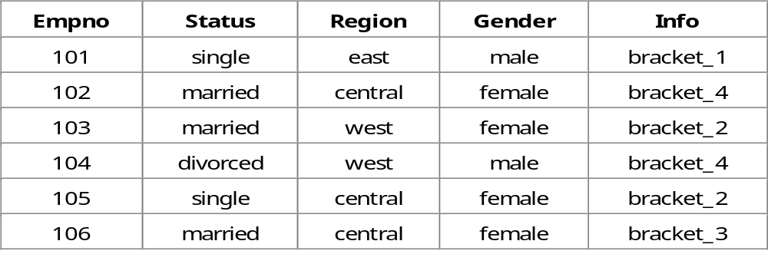
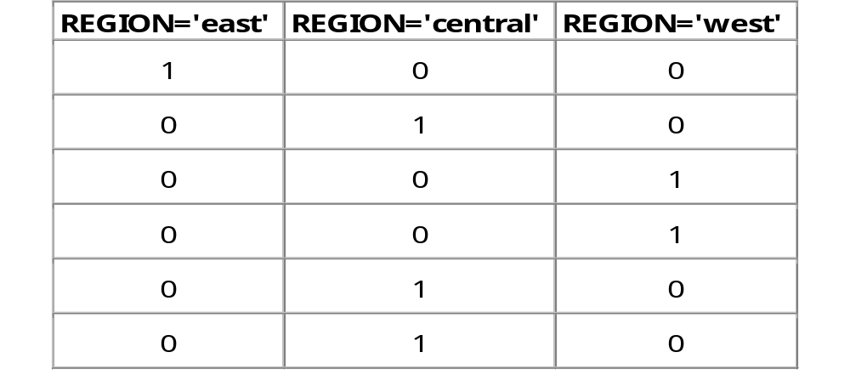
Bitmap Index

Slide 84
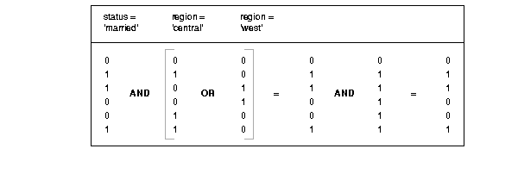
Bitmap Indexes
SELECT COUNT(*)
FROM CUSTOMER
WHERE MARITAL_STATUS = 'married‘
AND REGION IN ('central','west');

Slide 85
Bitmap Access, Single Table
SELECT count(*)
FROM customer
WHERE status=‘M’
AND region in (‘C’,’W’);
>.......TABLE ACCESS (BY INDEX ROWID) cust
>.........BITMAP CONVERSION to rowids
>...........BITMAP AND
>.............BITMAP INDEX single value cs
>.............BITMAP MERGE
>...............BITMAP KEY ITERATION
>.................BITMAP INDEX range scan cr
Bitmap OR’s, AND’s and CONVERSION
  Find Central and West bitstreams (bitmap key-iteration)
  Perform logical OR on them (bitmap merge)
  Find Married bitstream
  Perform logical AND on region bitstream (bitmap and)
  Convert to actual rowid’s
  Access table

Slide 86
Bitmap Access, Star Query
Bitmap indexes: id1, id2
SELECT sum(f)
FROM F,D1,D2
WHERE F=D1 and F=D2
AND D1.C1=<…>
AND D2.C2=<…>
F(pk, d1fk, d2fk, f)
D1(pk,c1,c2) D2(pk,c1,c2)
>.......TABLE ACCESS (BY INDEX ROWID) f
>.........BITMAP CONVERSION (TO ROWIDS)
>...........BITMAP AND
>.............BITMAP MERGE
>...............BITMAP KEY ITERATION
>.................TABLE ACCESS (FULL) d1
>.................BITMAP INDEX (RANGE SCAN) id1
>.............BITMAP MERGE
>...............BITMAP KEY ITERATION
>.................TABLE ACCESS (FULL) d2
>.................BITMAP INDEX (RANGE SCAN) id2

Slide 87
Warehouse Hints
Specific star-query related hints
  Star
    Traditional: via concat-index range scan
  Star_transformation
    Via single column bitmap index merges/and’s
  Fact(t) / No_fact(t)
    Help star_transformation
  Index_combine(t i1 i2 …)
    Explicitely instruct which indexes to merge/and

Slide 88
ETL options
New in 9i
  External tables
    Access external ASCII-file from SQL (FTS only)
  Merge (aka UpSert)
    Conditionally do an Insert or an Update
  Multi-Table-Insert (MTI)
    Conditionally insert subquery-result into multiple tables

Slide 89
Availability
  Oracle7
    Cost Based Optimizer
    Hash Join
  Oracle r8.0
    Bitmap indexes (without bugs)
    Star_transformation
    Rowid-format (dbms_rowid)
  Oracle 8i
    Dbms_Stats
  Oracle9i
    Index SkipScans
    First_rows(n)-hint

Slide 90
An Introduction…
Not covered,
    Distributed SQL
    Nested SQL
    PL/SQL Functions inside SQL
    Anti Joins
    View processing
    Index+hash clusters
    Partitioning / Parallelisation
    Index organised tables
    …

Slide 91
SQL Tuning: Roadmap
Able to read plan
Able to translate plan into 3GL program
    Know your row-source operators
Able to read SQL
Able to translate SQL into business query
    Know your datamodel
Able to judge outcome
    Know your business rules / data-statistics
      Better than CBO does
Experts:
  Optimize SQL while writing SQL…

Slide 92

Questions?
t.koppelaars@centraal.boekhuis.nl

